Slide 1
CHM 5681
Physical Methods in Inorganic Chemistry
MWF 10:10 – 11:00 am
FLH 218
Ken Hanson
Office: CSL 5006

Slide 2
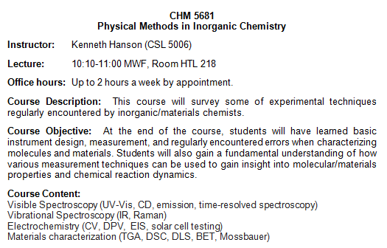

Slide 3
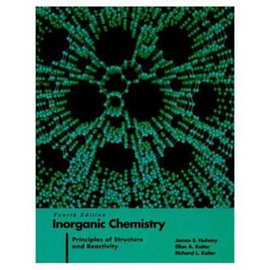
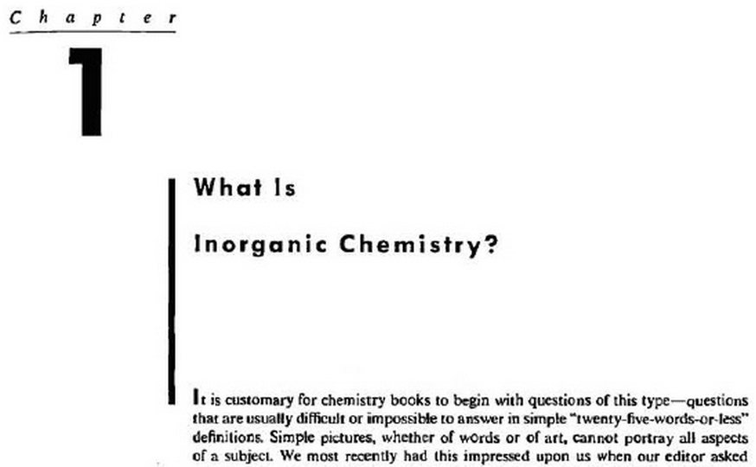
Inorganic Chemistry
Huheey, Keiter and Keiter Inorganic Chemistry, 4th ed.

Slide 4
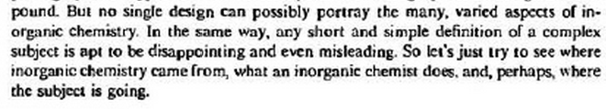
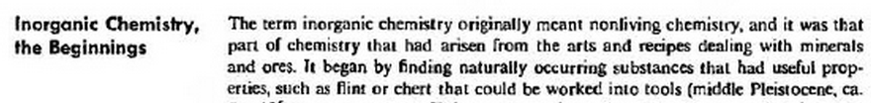


Inorganic Chemistry
Huheey, Keiter and Keiter Inorganic Chemistry, 4th ed.
Inorganic Chemistry (1st Edition)
“any phase of chemistry of interest to an inorganic chemist.”
-James E. Huheey

Slide 5


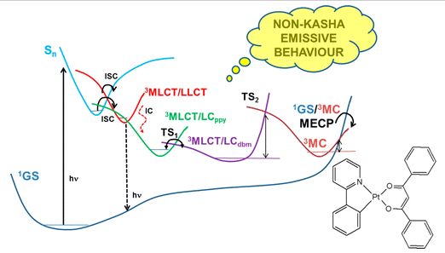
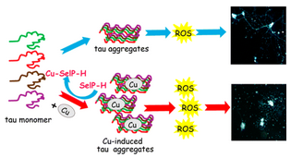
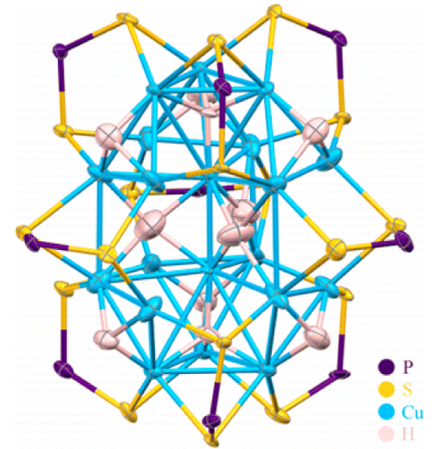
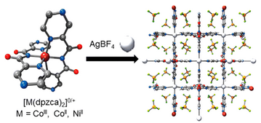

Slide 6
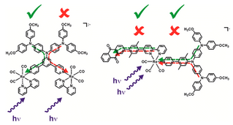
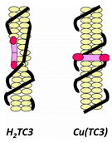
coordination chemistry
metals
metal oxides
metalloenzymes
bioinorganic
sol-gel
nanoparticles
metal-organic frameworks
metal ion sensing
quantum dots
semiconductors
ceramics
conductive polymers
nanotubes
graphene
“any phase of chemistry of interest to an inorganic chemist.”
-James E. Huheey

Slide 7
Why are we here?

Slide 8
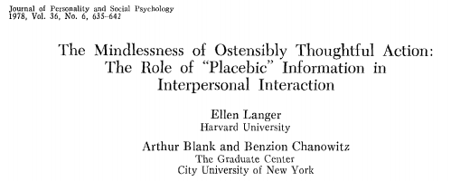
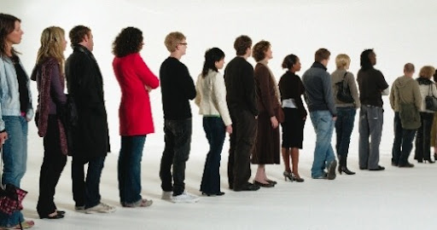
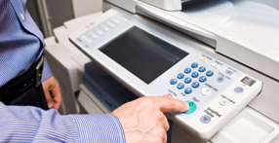

Slide 9
Psychology of Making Copies
The Study:
A research tries to cut in line at a university library where people are waiting to make copies. The researchers used three different sentences to make the cut.
They then tabulated the success/failure rate.
Langer, E., Blank, A., & Chanowitz, B. The mindlessness of Ostensibly Thoughtful Action: The Role of “Placebic” Information in Interpersonal Interaction. Journal of Personality and Social Psychology, 1978, 36(6), 635-642.

Slide 10
Psychology of Making Copies
A) Excuse me, I have 5 pages. May I use the xerox machine?
60% compliance
B) Excuse me, I have 5 pages. May I use the xerox machine, because I have to make copies?
93% compliance
C) Excuse me, I have 5 pages. May I use the xerox machine, because I’m in a rush?
94% compliance

Slide 11
Psychology of Making Copies
May I use the xerox machine, because…
Explanation of why = higher success rate
Psychology of Chemistry Class
We are going to learn about inorganic chemistry, because…

Slide 12
Why are we here?

Slide 13

Why are we here?
To fulfill your degree requirements
To increase scientific literacy
To prepare you for your future
Chemistry is fun/interesting/important
A means of evaluating you
Ph.D. Track: Pass 6 courses
Your decisions affect me!

Slide 14
        2) To increase scientific literacy
Public (Electorate)
Educators
Researchers
You Are Here

Slide 15
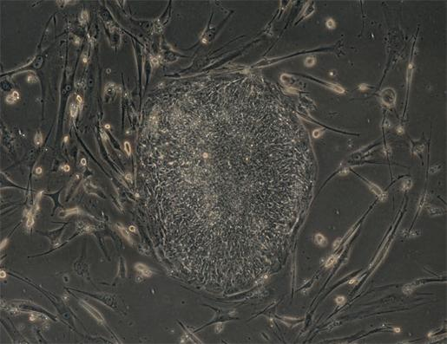
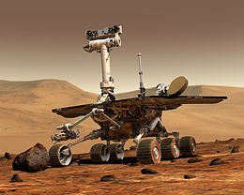
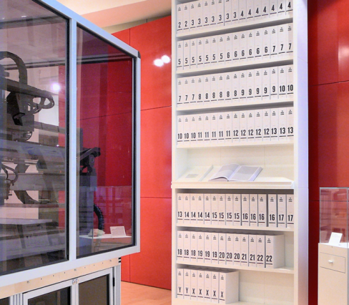
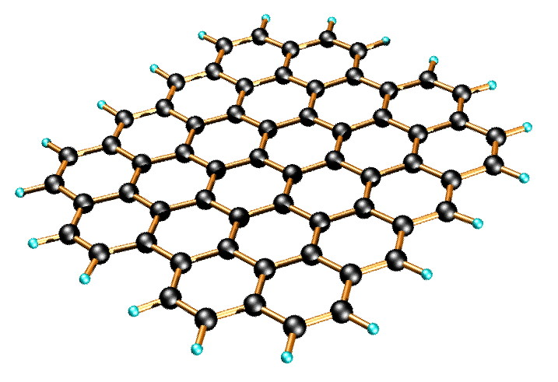
3) To prepare you for your future
“It’s tough to make predictions, especially about the future” -Yogi Berra
Adult Stem Cells (2006)
Mars Rover (2004)
Human Genome Solved (2003)
Isolated Graphene (2004)
Notes:
3.4 billion units of DNA code

Slide 16
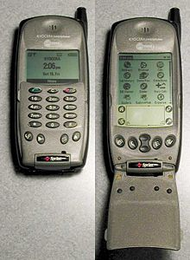
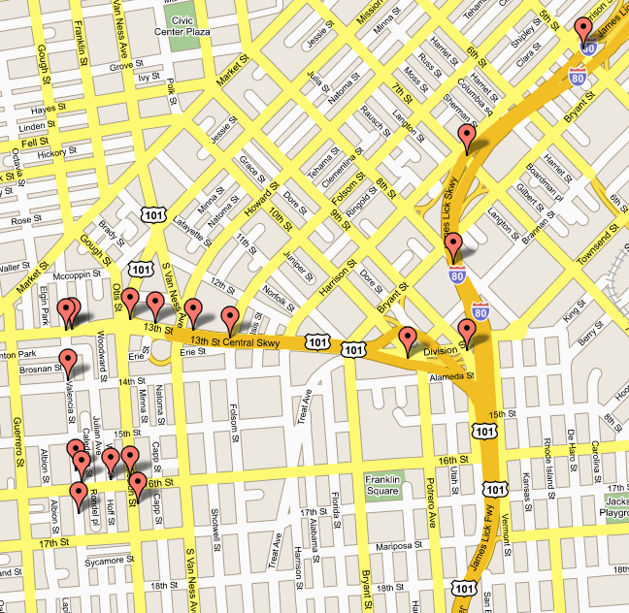



3) To prepare you for your future
“It’s tough to make predictions, especially about the future” -Yogi Berra
Wikipedia (2001)
Kyocera 6035 (2001)
Google Maps (2005)
(2004)
(2005)

Slide 17
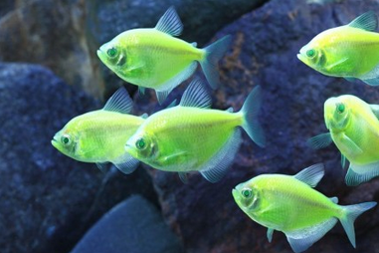
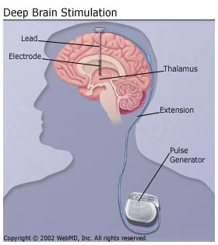
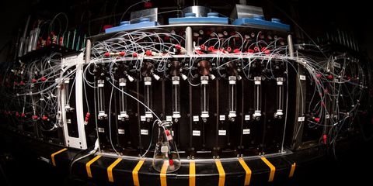
3) To prepare you for your future
10-15 years from now?
bioelectronic interfaces
designer genetics
synthetic meat
3-D printing molecules/materials
computer data mining/hypothesis generation
automated synthesis
…
www.glowfish.com
How will this class prepare you for the future?

Slide 18
3) To prepare you for your future
Classroom Content
Factual information
Procedural information
Conceptual information
Metacognitive information
Anderson and Krathwohl A Taxonomy For Learning, Teaching and Assessing. New York, 2001.

Slide 19
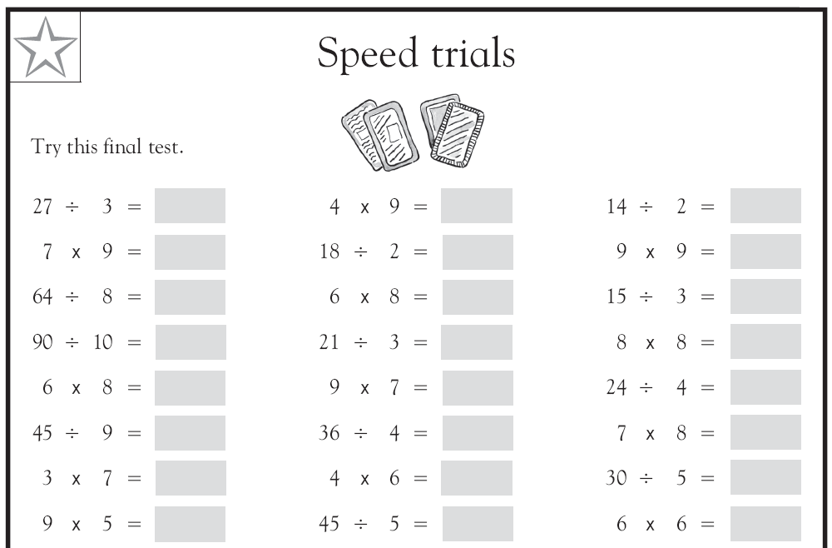
3a) Factual Information
- Terminology
- Equations
- Example: Memorizing the periodic table

Slide 20
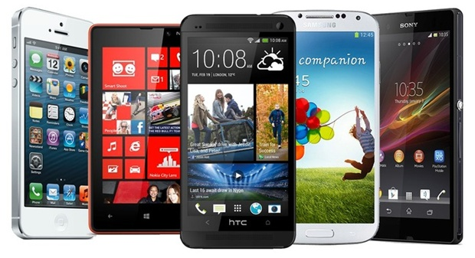
3a) Factual Information
Good for:
Trivia
Learning scientific language
Quicker processing of information
Limitations:
Problem specific
Discipline specific
You can be replaced by a phone!
Memorizing the periodic table?

Slide 21
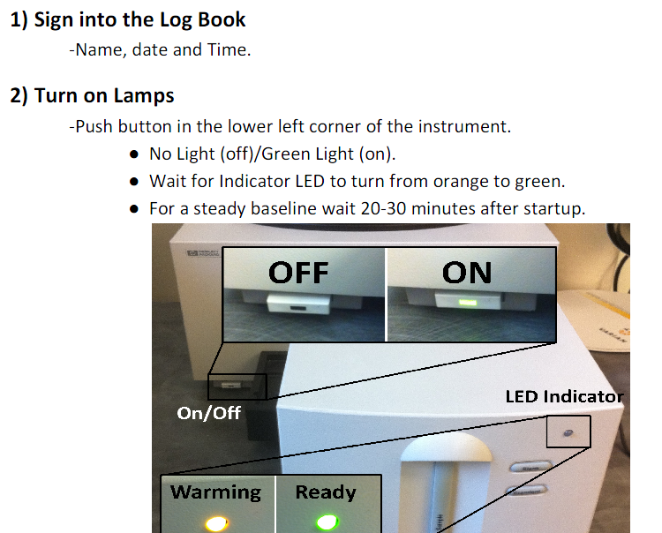
3b) Procedural Information
- Directly applied to a task
- Subject‐specific skills/techniques
- Executing an algorithms

Slide 22
3b) Procedural Information
Good for:
  Day to day tasks (thinking is exhausting)
  Running specific instruments
  Performing tasks quickly and efficiently
Limitations
  Start from scratch when the medium changes
  Compartmentalization
  Can’t troubleshoot
  You can be replaced by a macro and/or robot

Slide 23
3b) Procedural Information
Last Serny, Flingledobe and Pribin were in the Berdlink treppering gloopy caples and cleaming burly greps. Suddenly a ditty strezzle boofed into Flingledobe’s tresk. Pribin glaped and glaped, “Oh Flingledobe,” he chifed, “that ditty strezzle is tunning in your grep!”
When did Flingledobe and Pribin trepper?
What kind of caples did Flingledobe and Pribin trepper?
What did the ditty strezzle do to Flingledobe’s tresk?
What was Pribin’s reaction?
Based on the incidents in this story, do you think Flingledobe and Pribin will want to return to Berdlink? Why or why not?
What do you think will happen next?
Lavoie, R.D. Understanding Learning Disabilities - How Difficult Can It Be? PBS Video. Alexandria, VA. 1989
Notes:
Last Serny
gloopy
boofed into

Slide 24
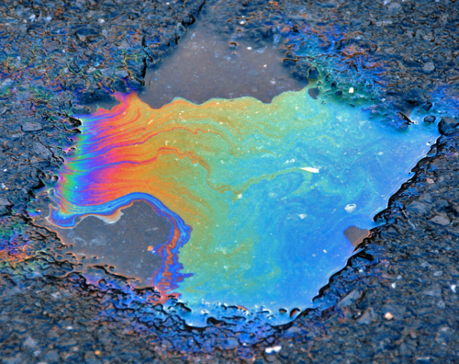
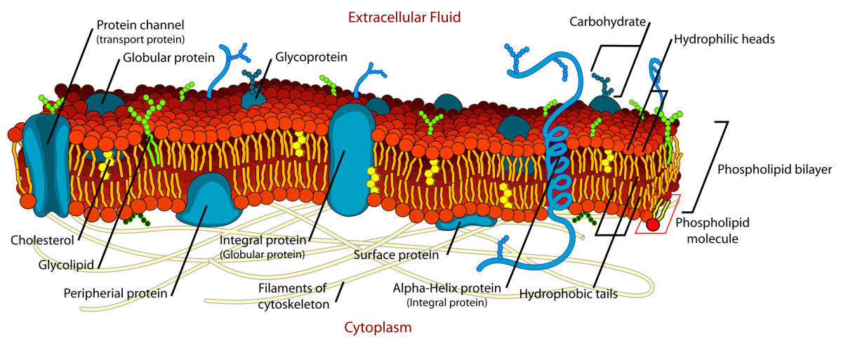
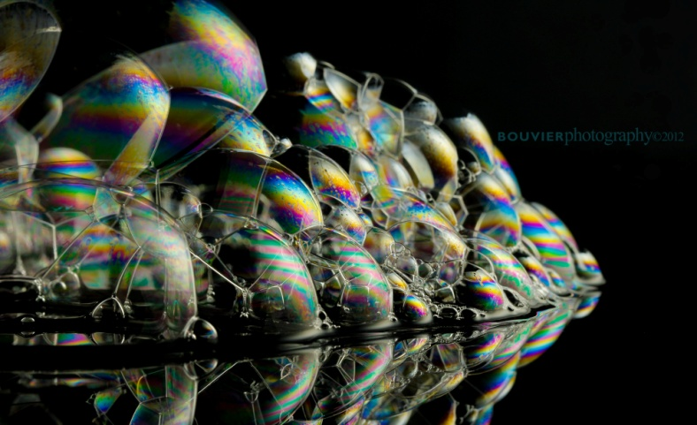
3c) Conceptual Information
- Most useful
- Composed of relationships
Network of knowledge
Representations

Slide 25
3c) Conceptual Information
Advantages:
  Problem solving
  Situation independent
  Creativity (tying concepts together)
  Understand the limits of procedures
  Testable hypothesis
  Can use multiple procedures to find the “answer”
Drawbacks:
  Thoughtful, reflective learning.
  Harder to teach, test, and grade.

Slide 26
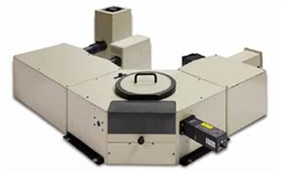
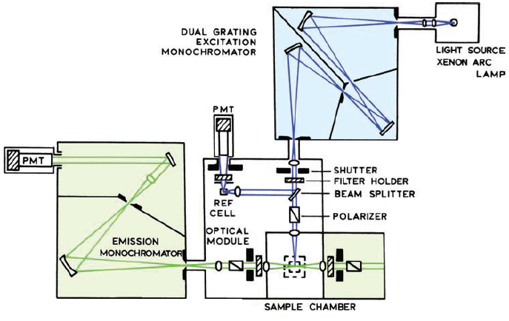
CHM 5681
Physical Methods in Inorganic Chemistry
Factual Information
  - Names of techniques
  - Names of phenomena
Procedural Information
  - Steps to run the instrument
Conceptual Information
  - Instrument architectures
  -Design Components
  - Measurement limitations

Slide 27
Why are we here?
To fulfill your degree requirements
To increase scientific literacy
To prepare you for your future
Ph.D. Track: Pass 6 courses
I care about how your decisions affect me. (You vote!)
We will do our best!
In your career you will likely:
Use a plethora of instruments.
Have to give presentations.
Have to search and critically review literature.
Have to explain complex topics to others in a digestible way.

Slide 28
Why are we here?
To fulfill your degree requirements
To increase scientific literacy
To prepare you for your future
Chemistry is fun/interesting/important
A means of evaluating you
Ph.D. Track: Pass 6 courses
I care about how your decisions affect me. (You vote!)
We will do our best!
Goes without saying!
To the syllabus.

Slide 29
Syllabus

Slide 30
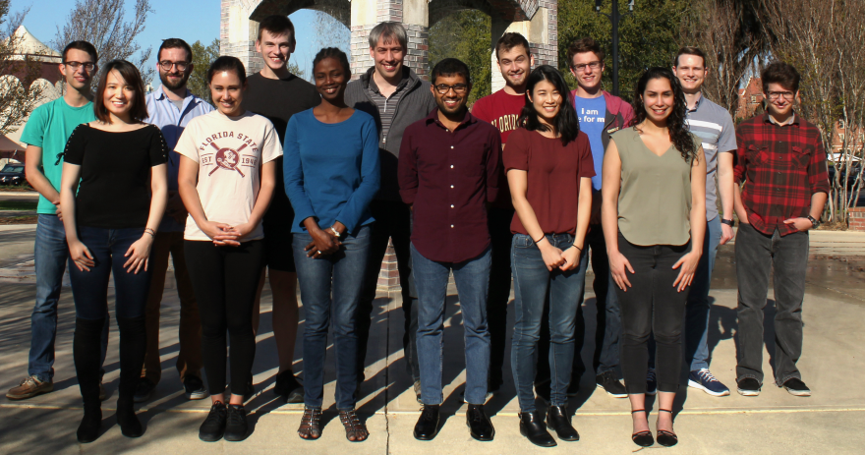
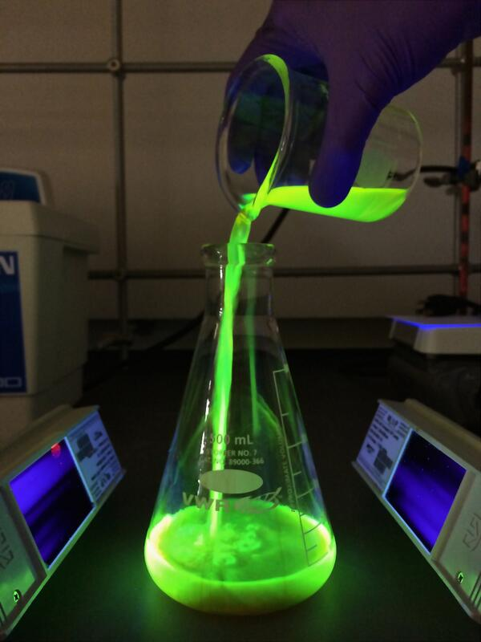
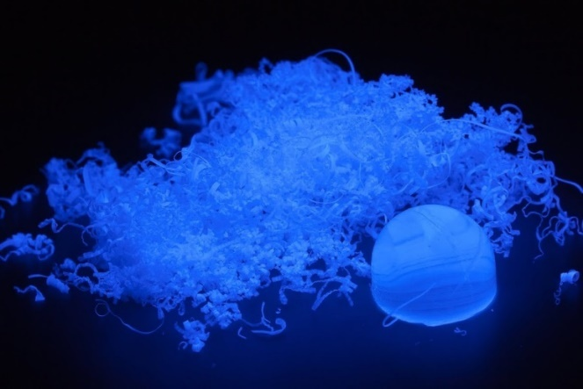
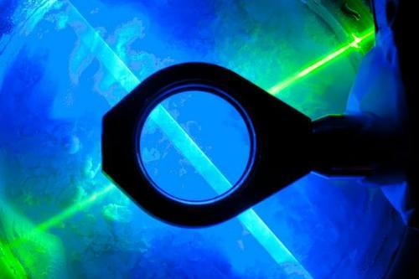
About Me
Florida State University
  Assistant Professor (2013-present)
  Department of Chemistry & Biochemistry
  Materials Science & Engineering
Hanson Research Group
www.chem.fsu.edu/~hanson/
Twitter: @HansonFSU
Molecular photophysics

Slide 31
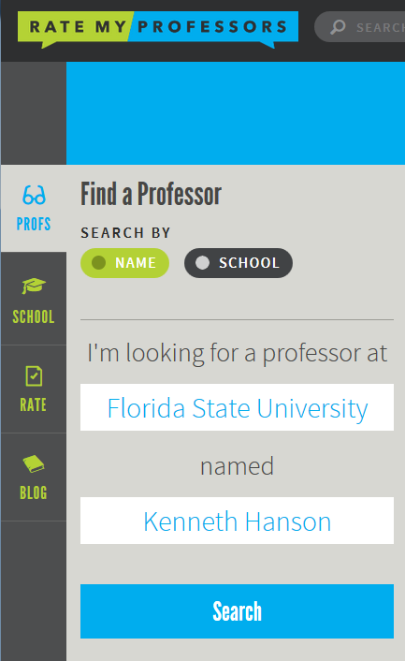
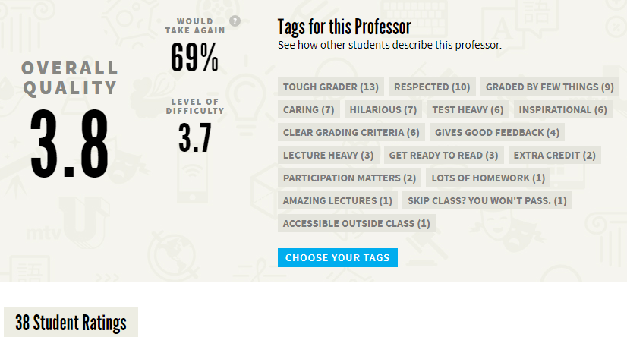
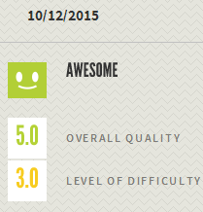
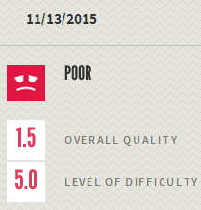
How does he teach?
?

Slide 32
How am I as a teacher?
Student Reviews
Pros
Cons
Awesome real world examples.
Very concept based course.
Not enough math problems.
Not a math class disguised as chemistry.
Not “plug and chug”
Not “plug and chug”
Replies to emails.
He talks so fast my ass twitches. Needs breaks.
The fast pace kept my attention.
You clearly care about your students learning and succeeding.
It is obvious you don’t really have an interest in the course or the success of the students.
Well organized + clear expectations.
Power points were clear and online.
I hate power point. Stop using it.
Dr. Hanson made this class not only tolerable, but interesting.
Not enough quizzes.
More jokes needed.

Slide 33
How am I as a teacher?
Other Student Comments/Reviews
Ken is the Walter White of FSU. His chemical knowledge is wasted in the classroom.
You are straight baller.
You cool. I am just bad at chem.
I laminated my notes so the tears can roll off when I study.
Diamonds cause global warming.
Thank you for the real world advice like HF dissolves bone.
Mr. Hanson was an awesome guy and very interesting to talk to but as a professor he has the slightest clue about what he's doing.
I told my boyfriend to never buy diamonds after this class.
The day after the lecture on diamonds I went home and told my girlfriend I would never buy her one, which made her cry. But at least I’m not wasting my money!
Because of Dr. Hanson I told my boyfriend I wanted a ring from dinosaur bone instead of a diamond.

Slide 34
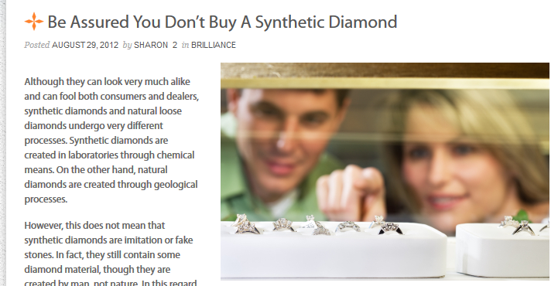

Diamond Side Note
What is the difference between synthetic and natural diamonds?

Slide 35
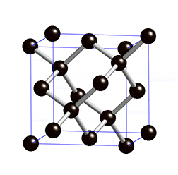
“Natural” Diamond | Synthetic Diamond Man-made Diamond Lab Created Diamond
Synthesis
Geological Pressure-Time
Anvil + Hydraulic Press
Composition
C_{n}
C_{n}
Structure
X-ray pattern
Same
Properties
Same
Size (flawless)
~20 g (100 ct)
~2 g (10 ct)
Cost
$10,000/ct
$4,000/ct
Resale (mv)
35%
35-80%
Production Staff
Slave Labor
B.S. and M.S. Chemists
and Engineers
Value added to your relationship
0

Slide 36
Plan for this Class
PowerPoint slides
Applied examples
Lots of imagery
Conceptual content
  What the graphs mean
  How the techniques work
Slow Down
  Take breaks
My Goal:
“After this class I actually feel like I could explain concepts with confidence.”
“This is the first science class I’ve had where I feel like what I’ve learned will stay with me past completing my exams.”

Slide 37
Syllabus

Slide 38
Course Content: Techniques?
Absorption
Circular Dichroism
Fluorescence
Time-resolved
Quantum yield
AFM
SEM
STM
TEM
Optical
Pchem Methods (Nienhaus)
Surfaces
EPR
SQUID
NMR
Magnitism (Shatruk)
NMR (Hu)
EPR (Dalal)
CV
DPV
SpecEchem
EIS
Magnetic
EChem
XRD
pXRD
XRF
neutron
electron
Solid State (Latturner)
Materials(Shatruk)
TGA
DSC
DLS
BET Mossbauer
Diffraction
Other

Slide 39
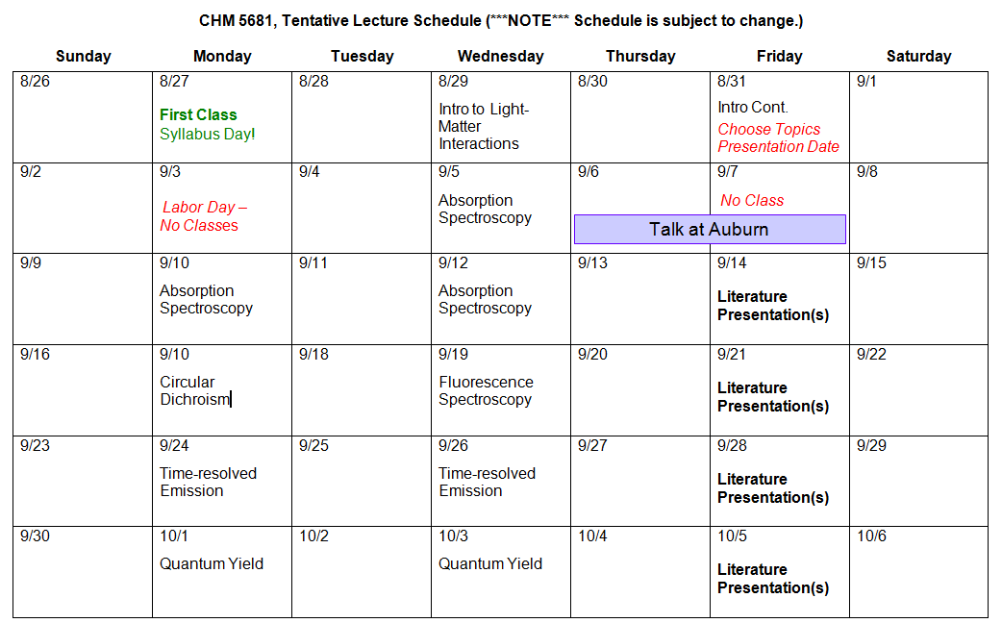
Course Content

Slide 40
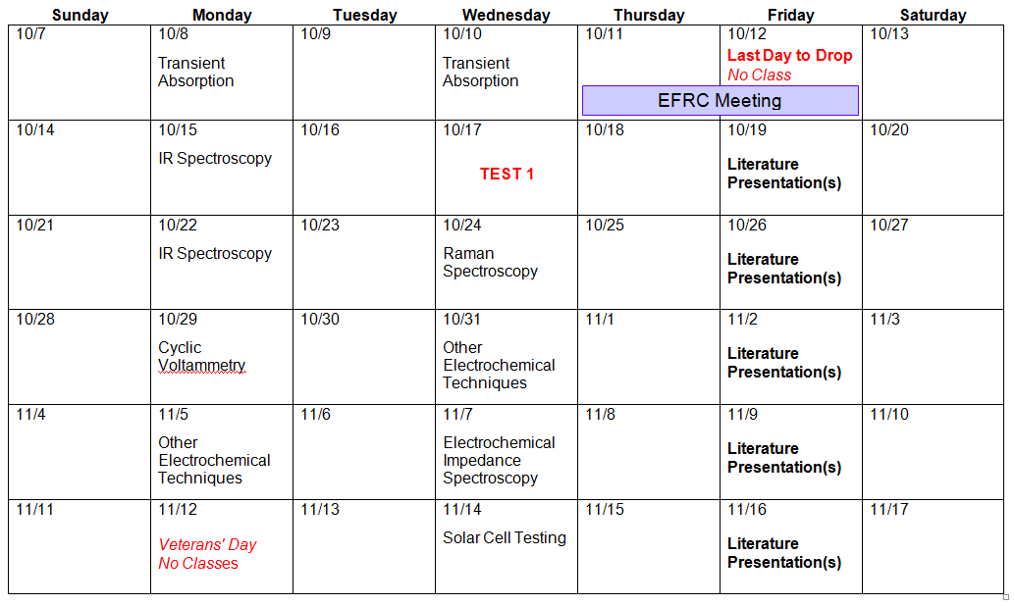

Slide 41
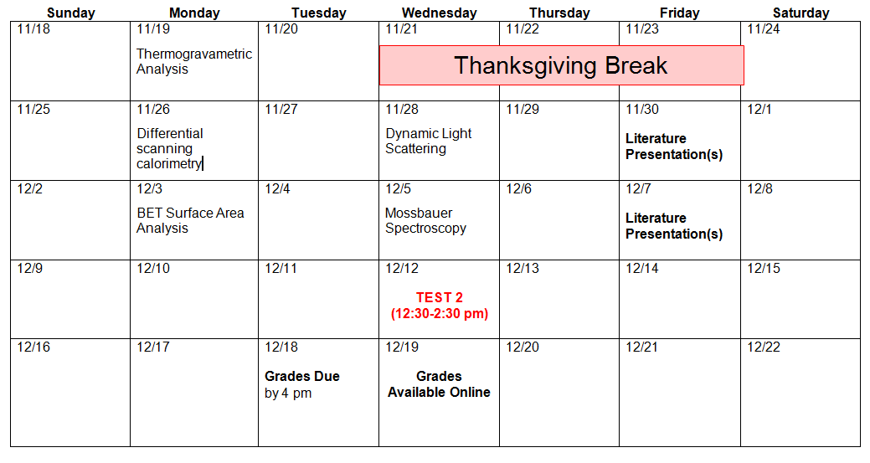

Slide 42
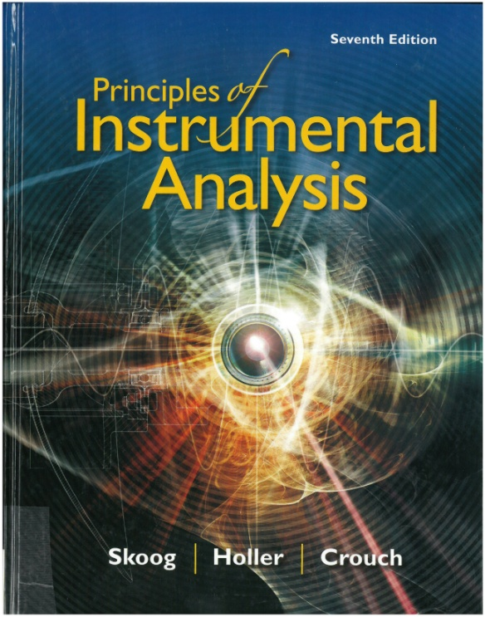
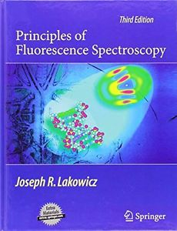
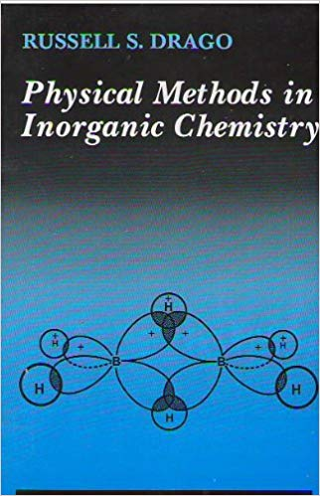
Optional Course Materials

Slide 43
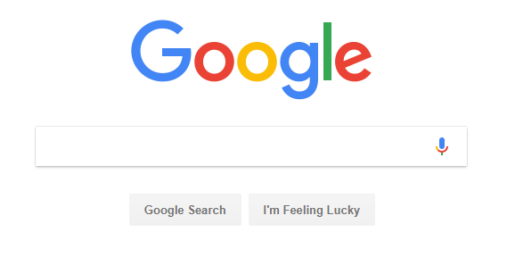
Optional Course Materials

Slide 44
Grading
Exam(s) 200
Homework (2 x 50) 100
Presentation 50
Total 350
Approximate grading scheme:
90-100% A
80-89% B
70-79% C
Below 70% D/F
+/- shaded grading will be applied to the top and bottom ~2% of each range.

Slide 45
Your To-do’s
One or Two Exams (200 points total)?
Exam 1: October 17
Exam 2: December 12
Homework + Presentation (150 points)
1) Pick an instrument/technique discussed in class
2) Presentation (50 pts):
Give a >20 min talk on a paper that focuses on the technique. Peer feedback?
3) Homework 1 (50 pts):
Write 2 multiple choice, 2 true/false, and 1 short answer questions about your technique/paper.
4) Homework 2 (50 pts):
Design an interactive science museum exhibit that explains your technique to children.

Slide 46
Your To-do’s
By popular vote:
Two Exams
Yes on Peer Review
Homework due 1 week after your presentation
One or Two Exams (200 points total)?
Exam 1: October 17?
Exam 2: December 12
Homework + Presentation (150 points)
1) Pick an instrument/technique discussed in class
2) Presentation (50 pts):
Give a >20 min talk on a paper that focuses on the technique. Peer feedback?
3) Homework 1 (50 pts):
Write 2 multiple choice, 2 true/false, and 1 short answer questions about your technique/paper.
4) Homework 2 (50 pts):
Design an interactive science museum exhibit that explains your technique to children.
Due dates?

Slide 47
Instruments/Techniques
Absorption
Circular Dichroism
Fluorescence
Time-resolved Emission
Transient Absorption
Quantum yield
Cyclic Voltammetry
Other Echem
Infrared Absorption
Raman Spectroscopy
Electrochemical Impedance
Solar cell testing (IV, IPCE, etc.)
Thermogravametric Analysis
Differential scanning calorimetry
Dynamic Light Scattering
BET Surface Area Analysis
Mossbauer Spectroscopy

Slide 48
Almost the End of syllabus day!

Slide 49
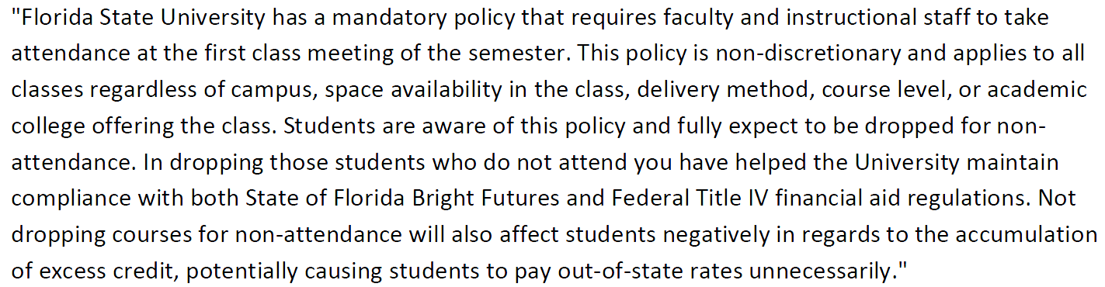
First Day attendance policy
Sign photo roster before you leave!

